Slide 1
Algebraic Reconstruction Techniques on Sinogram Image of Solder Ball Grid
Rohit Das
Advised By – Prof. Chiou-Shann Fuh
61047086s@ntnu.edu.tw
+886-0905023713

Slide 2
Research progress
ART
MART

Slide 3

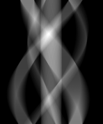


ART
Since the algorithm uses column wise projection,
I experimented with row wise projection.
179$°$
0$°$
Original Image
Original Sinogram

Slide 4
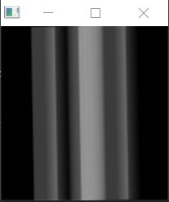
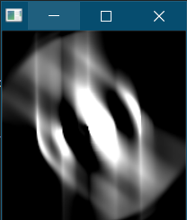
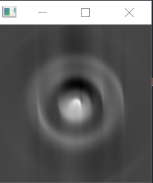
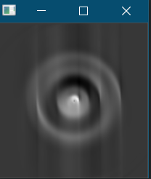
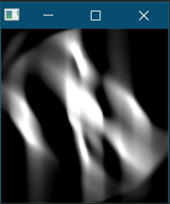
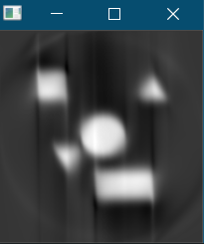
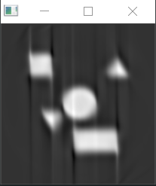








The Results Per Projection
←Row Wise
1$°$
50$°$
180$°$
180$°$ After 500 Iterations
←Column Wise
1$°$
50$°$
180$°$
180$°$ After 500 Iterations

Slide 5
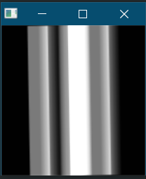
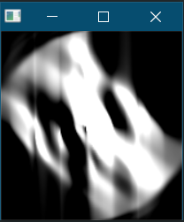
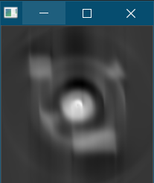
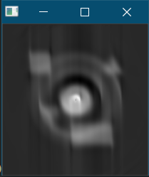




What Happens If We Add Both Column and Row Projection?
1$°$
50$°$
180$°$
180$°$ After 500 iterations

Slide 6
Multiplicative Algebraic Reconstruction Technique(MART)
Using multiplicative method to reconstruct the image from Sinogram
While ART converges in the consistent case to a minimal norm solution,
MART is designed to converge to a solution which minimizes entropy

Slide 7
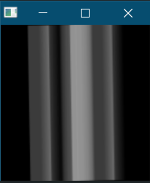
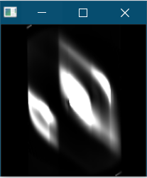
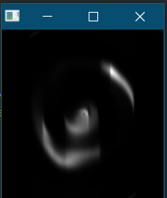
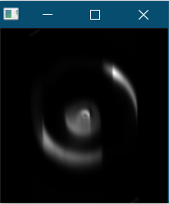
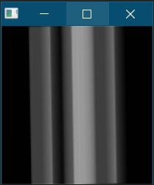
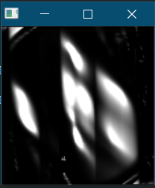
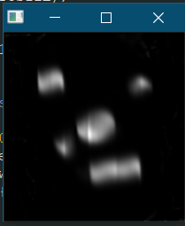
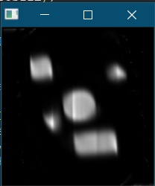








The Results Per Projection
←Row Wise
1$°$
50$°$
180$°$
180$°$ After 500 Iterations
←Column Wise
1$°$
50$°$
180$°$
180$°$ After 500 Iterations

Slide 8
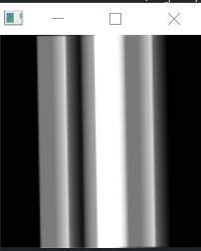
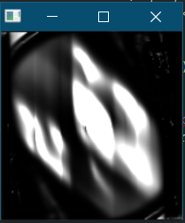
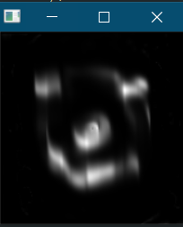
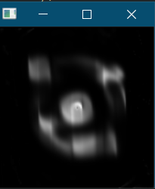




What Happens If We Add Both Column and Row Projection?
1$°$
50$°$
180$°$
180$°$ After 500 Projection

Slide 9
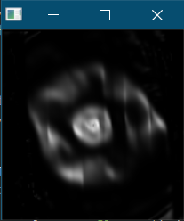
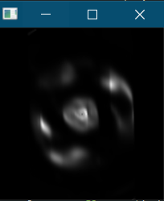
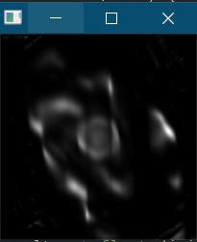
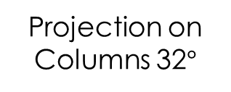
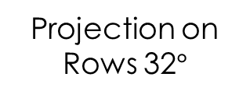

How about We Change The Projection?
Sum of Row and Columns on 32$°$
Projection on Rows 32$°$
Projection on Columns 32$°$
Above examples are done on MART with iteration = 500

Slide 10
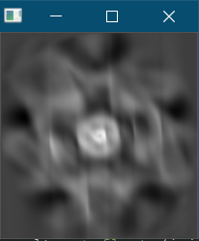
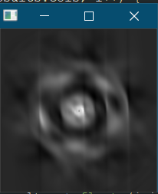
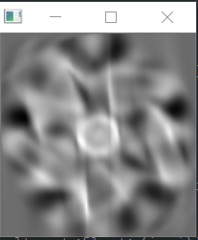

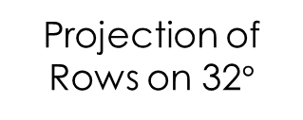
How about We Change The Projection?
Sum of Row and Columns on 32$°$
Projection of Rows on 32$°$
Projection of Columns on 32$°$
Above examples are done on ART with iteration = 500

Slide 11
Conclusion
Row wise reconstruction makes the details converge more in the middle.
But if we can mix both of them up in further researches, we might be able to retain more information.
ART is much better at preserving the details, structure of the image.
Multiplicative ART loses details at lower projection value, but retains good amount of information at the higher projection and iteration.

Slide 12
Thank You!

